Slide 1

Python Programming

Slide 2
Python Programming
Chapter 0: Course Introduction

Slide 3
PYTHON
Lecturer: Kim Ngọc Bách
Email: bachkn@ptit.edu.vn
Zalo: 0828191269

Slide 4
What do we learn in this course?
Fundamental skills in Python programming.
Introduce some well-known Python libraries.

Slide 5
What do we learn in this course?
Some Text-Books:
[1]. Eric Matthes. Python crash course: a hands-on, project-based introduction to programming, No Starch Press, 2016.
[2]. Allen B. Downey, Think Python: How to Think Like a Computer Scientist, O’Reilly, 2015
[3]. Zed A. Shaw, Learn Python 3 the Hard Way, Addison-Wesley, 2016

Slide 6
2. Why do we learn Python?
Mandatory course.
Prepare for other courses.
Prepare for the job market.

Slide 7
3. How do we learn this course
15 lecture combine with practical exercises.
3 practical session.

Slide 8
4. Assessment
Practical exercises - 10%.
Assignment 1 - 20%.
Assignment 2 - 20%.
Final Exam - 60%.

Slide 9
Python Programming
Chapter 1: Introduction

Slide 10
Agenda
Introduction
Python History
Getting Started
Installing Python.
Installing text editor.
Your first Python program: Hello world!

Slide 11
1.1 Introduction
Chapter 1: Introduction
Chapter 2: Variables and Simple Data Types
Chapter 3: Python Lists
Chapter 4: Condition Statements (If else)
Chapter 5: Dictionaries
Chapter 6: User Input and While Loop
Chapter 7: Functions
Chapter 8: Classes
Chapter 9: File and exceptions
Chapter 10: Python Applications

Slide 12
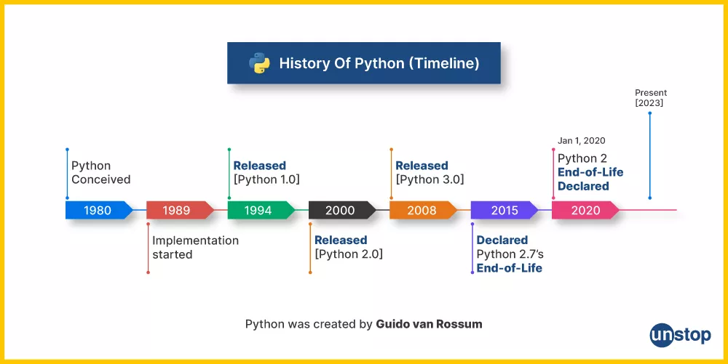
1.1 Brief History of Python
[*] https://unstop.com/blog/what-is-python

Slide 13
1.2 Getting Started
Installing Python:
[*] https://realpython.com/installing-python/
A better way to do things: Using Anaconda to manage environment and package
[**] https://docs.anaconda.com/free/anaconda/install/index.html

Slide 14
1.3 Getting Started
Text Editor for Python: Any text editor can do the job.
Some popular IDE for Python:
Pycharm
Visual Studio Code
Jupiter notebook
[*] https://www.dataquest.io/blog/jupyter-notebook-tutorial/

Slide 15
1.4 Introduction to Python programming
# First Python program
print("Hello World")

Slide 16
1.4 Introduction to Python programming
Comments in Python are indicated by a pound sign (#), and anything on the line following the pound sign is ignored by the interpreter.
End-of-Line terminates a Statement.
If you'd like a statement to continue to the next line, it is possible to use the "\" marker to indicate this.
Semicolon can optionally terminate a statement
In Python, code blocks are denoted by indentation.
In Python, indented code blocks are always preceded by a colon (:) on the previous line.

Slide 17
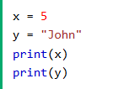


1.4 Your First Python Program
1.4.1 Variables
Variables are containers for storing data values.
Python has no command for declaring a variable.
A variable is created the moment you first assign a value to it.
If you want to specify the data type of a variable, this can be done with casting.
You can get the data type of a variable with the type() function.

Slide 18
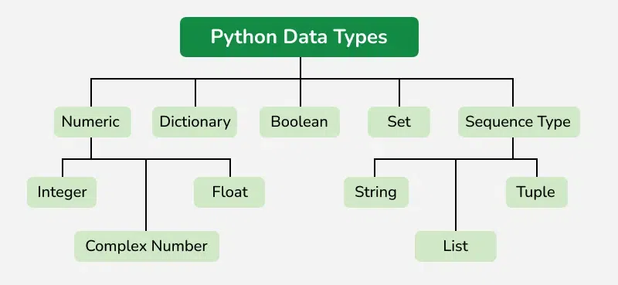
1.4 Your First Python Program
1.4.2 Data Types
Everything is an object in Python programming, Python data types are classes and variables are instances (objects) of these classes.
[*] https://www.geeksforgeeks.org/python-data-types/

Slide 19
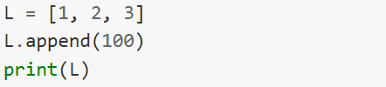


1.4 Your First Python Program
1.4.3 Objects and Dynamic Typing
In object-oriented programming languages like Python, an object is an entity that contains data along with associated metadata and/or functionality.
In Python everything is an object, which means every entity has some metadata (called attributes) and associated functionality (called methods).
These attributes and methods are accessed via the dot syntax.

Slide 20
1.4 Your First Python Program
1.4.3 Objects and Dynamic Typing
Python has types; however, the types are linked not to the variable names but to the objects themselves.

Slide 22
Python Programming
Chapter 2: Variables and Simple Data Types

Slide 23
Agenda
Variables
Strings
Numbers
Comments

Slide 24
2.1 Variables
What is Python variable?
Variables are containers for storing data values.
Python has no command for declaring a variable.
A variable is created the moment you first assign a value to it.
Variables do not need to be declared with any particular type, and can even change type after they have been set.
If you want to specify the data type of a variable, this can be done with casting.

Slide 25



2.1 Variables

Slide 26




2.2 Strings
Strings in python are surrounded by either single quotation marks, or double quotation marks.
Strings are list of character

Slide 27


2.2 Strings
Some useful string methods:
upper() : convert string to upper-case
lower(): convert string to lower-case
find(): find a value and return position where it was found
join(): join all the elements of an iterable into a string
More at [*] https://www.w3schools.com/python/python_ref_string.asp

Slide 28

2.3 Numbers
There are three numeric types in Python:
Integer - Float - Complex

Slide 29
2.4 Comments
Single Line comment using: #comments
Multiple Line comment using triple quotation: ‘’’ comments‘’’

Slide 30
Python Programming
Chapter 3: Python Data Types - List

Slide 31

3.1 What are Lists?
Lists are used to store multiple items in a single variable.
Lists are one of 4 built-in data types in Python used to store collections of data, the other 3 are Tuple, Set, and Dictionary, all with different qualities and usage.

Slide 32

3.2 List Items
List items are ordered, changeable, and allow duplicate values.
List items are indexed, the first item has index [0], the second item has index [1] etc.
When we say that lists are ordered, it means that the items have a defined order, and that order will not change.
The list is changeable, meaning that we can change, add, and remove items in a list after it has been created.
Since lists are indexed, lists can have items with the same value:

Slide 33


3.2 List Items
To determine how many items a list has, use the len() function:
List items can be of any data type:
A list can contain different data types:
The list() Constructor

Slide 34


3.3 Access Lists Items
List items are indexed and you can access them by referring to the index number:
Negative Indexing
Negative indexing means start from the end
-1 refers to the last item, -2 refers to the second last item etc.

Slide 35
3.3 Access Lists Items
Range of Indexes
You can specify a range of indexes by specifying where to start and where to end the range.
When specifying a range, the return value will be a new list with the specified items.

Slide 36

3.3 Access Lists Items
Check if Item Exists
To determine if a specified item is present in a list use the in keyword:

Slide 37




3.3 Change list items
To change the value of a specific item, refer to the index number:
To change the value of items within a specific range, define a list with the new values, and refer to the range of index numbers where you want to insert the new values:

Slide 38

3.4 Insert List Items
To insert a new list item, without replacing any of the existing values, we can use the insert() method.
The insert() method inserts an item at the specified index:

Slide 39




3.5 Add List Items
To add an item to the end of the list, use the append() method:
To append elements from another list to the current list, use the extend() method.

Slide 40
3.6 Remove List Items
The remove() method removes the specified item.
If there are more than one item with the specified value, the remove() method removes the first occurrence.
The pop() method removes the specified index.
If you do not specify the index, the pop() method removes the last item.

Slide 41


3.7 Loop through a list
You can loop through the list items by using a for loop:
You can also loop through the list items by referring to their index number. Use the range() and len() functions to create a suitable iterable.

Slide 42
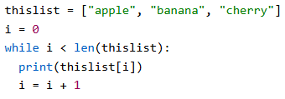
3.7 Loop through a list
You can loop through the list items by using a while loop. Use the len() function to determine the length of the list, then start at 0 and loop your way through the list items by referring to their indexes. Remember to increase the index by 1 after each iteration.

Slide 43
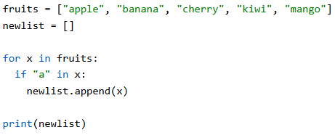
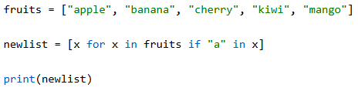
3.8 List comprehension
List comprehension offers a shorter syntax when you want to create a new list based on the values of an existing list.

Slide 44
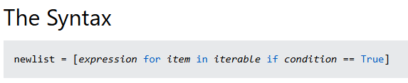
3.8 List comprehension
[f(x) if condition else g(x ) for x in iterables]
Or
[expression_1 if condition else expression_2 for x in iterables]

Slide 45
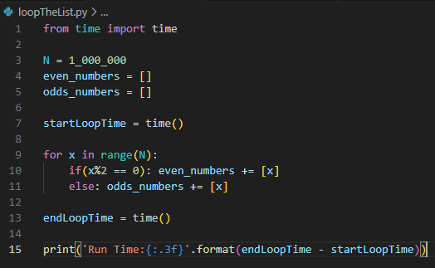
3.8 List comprehension

Slide 46
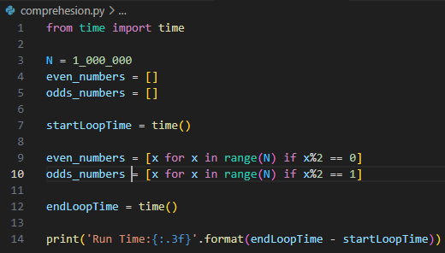
3.8 List comprehension

Slide 47
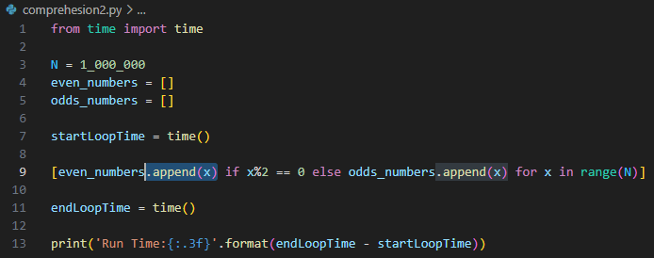
3.8 List comprehension

Slide 48


3.9 Sort list
List objects have a sort() method that will sort the list alphanumerically, ascending, by default:
To sort descending, use the keyword argument reverse = True:

Slide 49


3.10 Copy list
You cannot copy a list simply by typing list2 = list1, because: list2 will only be a reference to list1, and changes made in list1 will automatically also be made in list2
You can use the built-in List method copy() to copy a list.

Slide 50


3.10 Copy list
You can use the built-in List method copy() to copy a list.
Another way to make a copy is to use the built-in method list().
Use the slice Operator

Slide 51
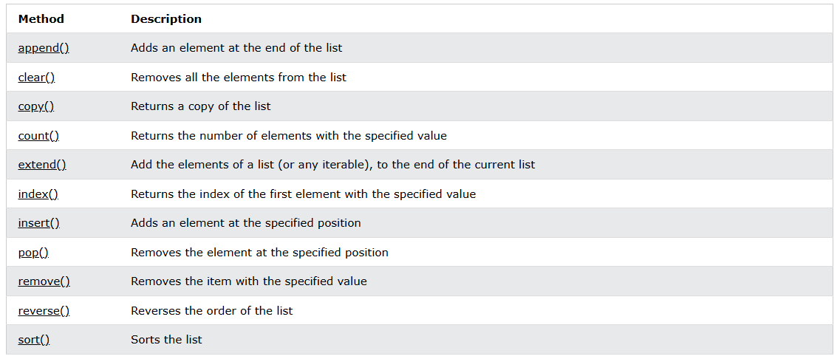

Slide 52
3.6 Lists Comprehension
[f(x) if condition else g(x ) for x in iterables]

Slide 53
firstName = [“Steven”, “Frank”, “Luis”, “Andy”]
lastName = [“G.” , “L.”, “S.”, “C.”]
Print to console:
Steven G.
Frank L.
Luis S.
Andy C.

Slide 54
Python Dictionary

Slide 55
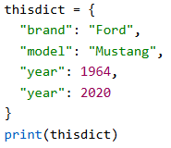
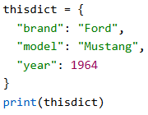
What is dictionary
Dictionaries are used to store data values in key:value pairs.
A dictionary is a collection which is ordered*, changeable and do not allow duplicates.

Slide 56
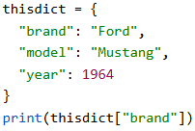
2. Access Dictionary Items
We can access the items of a dictionary by referring to its key name, inside square brackets.
There is also a method called get() that will give the same result.
The keys() method will return a list of all the keys in the dictionary.

Slide 57
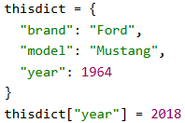
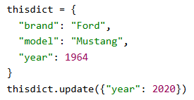
3. Change/Add Dictionary Items
We can change the value of a specific item by referring to its key name.
The update() method will update the dictionary with the items from the given argument. The argument must be a dictionary, or an iterable object with key:value pairs.

Slide 58
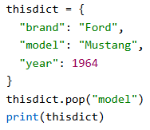
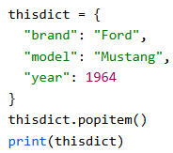
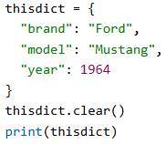
3. Remove Dictionary Items
The pop() method removes the item with the specified key name:
The popitem() method removes the last inserted item (in versions before 3.7, a random item is removed instead).
The clear() method empties the dictionary.

Slide 59
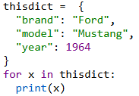
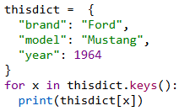
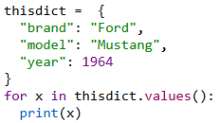
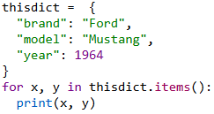
4. Loop through Dictionary

Slide 60
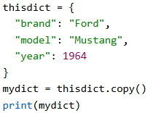
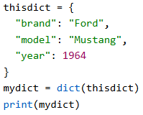
5. Copy Dictionary
Make a copy of a dictionary with the copy() method:
Another way to make a copy is to use the built-in function dict().

Slide 61
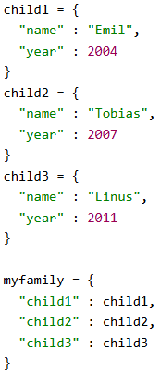

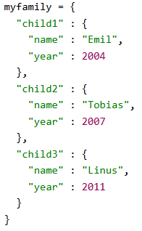
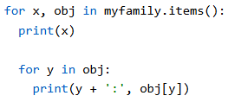
6. Nested Dictionary

Slide 62
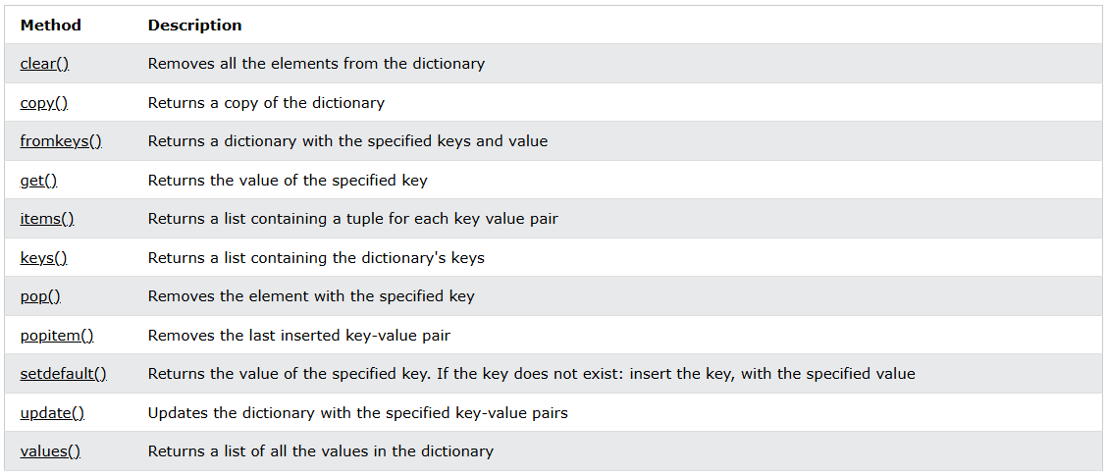

Slide 63
Python Programming
Chapter 4: Python Function

Slide 64
4.1 Define a Function
Using “def” keyword
Function Name
Input Argument

Slide 65
4.2 Input Arguments
Immutable Arguments:
Numeric
String
Tuples
Mutable Arguments:
List
Dictionary

Slide 66
4.2 Input Arguments
A Function can take multiple arguments.
Positional Arguments:
Keyword Arguments:

Slide 67
4.3 Function as an Argument
Function is first class object.
Function can be pass as an argument to another function
Lambda Function: Anonymous Function.

Slide 68
4.4 Python Closures
A function nested in a function
Useful for:
Function Factories
Callbacks: event-driven programming
Wrapper Function
Caching

Slide 69
4.5 Generator
Generators are special Python function that return iterator.
Generators are lazy.
Only compute on demand
Generator helps to save memory and cpu in many cases.

Slide 70
Python Programming
Chapter 5: Python OOPs Concepts

Slide 71
OOPs Concepts in Python
Class in Python
Objects in Python
Polymorphism in Python
Encapsulation in Python
Inheritance in Python
Data Abstraction in Python

Slide 72
Python Class
“A class is a collection of objects. Classes are blueprints for creating objects. A class defines a set of attributes and methods that the created objects (instances) can have.”
Some points on Python class:
Classes are created by keyword class.
Attributes are the variables that belong to a class.
Attributes are always public and can be accessed using the dot (.) operator.

Slide 73
2. Python Objects
An Object is an instance of a Class. It represents a specific implementation of the class and holds its own data.
An object consists of:
State: It is represented by the attributes and reflects the properties of an object.
Behavior: It is represented by the methods of an object and reflects the response of an object to other objects.
Identity: It gives a unique name to an object and enables one object to interact with other objects.

Slide 74
2. Python Objects
Self Parameter
self parameter is a reference to the current instance of the class. It allows us to access the attributes and methods of the object.

Slide 75
2. Python Objects
__init__ Method
__init__ method is the constructor in Python, automatically called when a new object is created. It initializes the attributes of the class.
__str__/__repr__ Method
Return a string representation for an object

Slide 76
3. Class and Instance Variables
In Python, variables defined in a class can be either class variables or instance variables, and understanding the distinction between them is crucial for object-oriented programming.
Class Variables
These are the variables that are shared across all instances of a class. It is defined at the class level, outside any methods. All objects of the class share the same value for a class variable unless explicitly overridden in an object.
Instance Variables
Variables that are unique to each instance (object) of a class. These are defined within the __init__ method or other instance methods. Each object maintains its own copy of instance variables, independent of other objects.

Slide 77
4. Python Inheritance
Inheritance allows a class (child class) to acquire properties and methods of another class (parent class). It supports hierarchical classification and promotes code reuse.
Types of Inheritance:
Single Inheritance: A child class inherits from a single parent class.
Multiple Inheritance: A child class inherits from more than one parent class.
Multilevel Inheritance: A child class inherits from a parent class, which in turn inherits from another class.
Hierarchical Inheritance: Multiple child classes inherit from a single parent class.
Hybrid Inheritance: A combination of two or more types of inheritance.

Slide 78
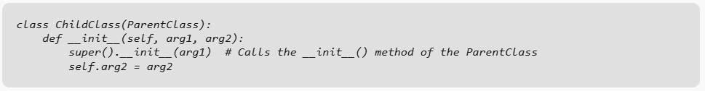
4. Python Inheritance
super() is used to call methods of a superclass (parent class) from a subclass (child class). It returns a proxy object that delegates method calls to the superclass. This is useful for accessing inherited methods that have been overridden in a subclass.

Slide 79
5. Polymorphism
Polymorphism allows methods to have the same name but behave differently based on the object’s context. It can be achieved through method overriding or overloading.

Slide 80
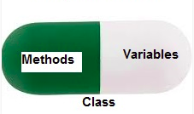
6. Encapsulation
Encapsulation is the bundling of data (attributes) and methods (functions) within a class, restricting access to some components to control interactions.
A class is an example of encapsulation as it encapsulates all the data that is member functions, variables, etc.
Types of Encapsulation:
Public Members: Accessible from anywhere.
Protected Members: Accessible within the class and its subclasses.
Private Members: Accessible only within the class.

Slide 81
7. Data Abstraction
Abstraction hides the internal implementation details while exposing only the necessary functionality. It helps focus on “what to do” rather than “how to do it.”
Types of Abstraction:
Partial Abstraction: Abstract class contains both abstract and concrete methods.
Full Abstraction: Abstract class contains only abstract methods (like interfaces).

Slide 82
Python Programming
Python Applications

Slide 83
Working with file
The key function for working with files in Python is the open() function.
The open() function takes two parameters; filename, and mode.
There are four different methods (modes) for opening a file:
"r" - Read - Default value. Opens a file for reading, error if the file does not exist
"a" - Append - Opens a file for appending, creates the file if it does not exist
"w" - Write - Opens a file for writing, creates the file if it does not exist
"x" - Create - Creates the specified file, returns an error if the file exists
In addition you can specify if the file should be handled as binary or text mode
"t" - Text - Default value. Text mode
"b" - Binary - Binary mode (e.g. images)

Slide 84
Working with file
The open() function returns a file object, which has a read() method for reading the content of the file:
f = open("demofile.txt", "r")
print(f.read())
By default the read() method returns the whole text, but you can also specify how many characters you want to return:
f = open("demofile.txt", "r")
print(f.read(5))
You can return one line by using the readline() method:
f = open("demofile.txt", "r")
print(f.readline())

Slide 85
Working with file
By looping through the lines of the file, you can read the whole file, line by line:
f = open("demofile.txt", "r")
for x in f:
print(x)
It is a good practice to always close the file when you are done with it.
f = open("demofile.txt", "r")
print(f.readline())
f.close()

Slide 86
Working with file
Best practice is using Context Manager:
with open("demofile.txt", "r")as f:
for x in f:
print(x)

Slide 87
Working with file
To write to an existing file, you must add a parameter to the open() function:
"a" - Append - will append to the end of the file
"w" - Write - will overwrite any existing content
f = open("demofile2.txt", "a") f.write("Now the file has more content!") f.close() f = open("demofile2.txt", "r") print(f.read()) | f = open("demofile3.txt", "w") f.write("Woops! I have deleted the content!") f.close() f = open("demofile3.txt", "r") print(f.read())

Slide 88
Working with file
To create a new file in Python, use the open() method, with one of the following parameters:
"x" - Create - will create a file, returns an error if the file exists
"a" - Append - will create a file if the specified file does not exists
"w" - Write - will create a file if the specified file does not exists
f = open("myfile.txt", "w")
f = open("myfile.txt", "x")

Slide 89
Working with file
To delete a file, you must import the OS module, and run its os.remove() function:
import os
os.remove("demofile.txt")
To avoid getting an error, you might want to check if the file exists before you try to delete it:
import os
if os.path.exists("demofile.txt"):
os.remove("demofile.txt")
else:
print("The file does not exist")
To delete an entire folder, use the os.rmdir() method:
import os
os.rmdir("myfolder")

Slide 90
II. Requests
Make a request to a web page, and print the response text:
import requests
x = requests.get('https://w3schools.com/python/demopage.htm')
#print(x.text)
print(x.content)
The requests module allows you to send HTTP requests using Python.
The HTTP request returns a Response Object with all the response data (content, encoding, status, etc).

Slide 91
II. Requests
Syntax: requests.methodname(params)
Methods:
delete(url, args) | Sends a DELETE request to the specified url
get(url, params, args) | Sends a GET request to the specified url
head(url, args) | Sends a HEAD request to the specified url
patch(url, data, args) | Sends a PATCH request to the specified url
post(url, data, json, args) | Sends a POST request to the specified url
put(url, data, args) | Sends a PUT request to the specified url
request(method, url, args) | Sends a request of the specified method to the specified url

Slide 92
III. BeatifulSoup
BeautifulSoup is used to parse HTML and XML in python.
import requests
from bs4 import BeautifulSoup
URL = "https://realpython.github.io/fake-jobs/"
page = requests.get(URL)
soup = BeautifulSoup(page.content, "html.parser")

Slide 93
IV. Pandas
Load a CSV file into a Pandas DataFrame:
import pandas as pd
df = pd.read_csv('data.csv')
print(df.to_string())

Slide 94
IV. Pandas
A Pandas DataFrame is a 2 dimensional data structure, like a 2 dimensional array, or a table with rows and columns.
import pandas as pd
data = {
"calories": [420, 380, 390],
"duration": [50, 40, 45]
}
#load data into a DataFrame object:
df = pd.DataFrame(data)
print(df)

Slide 95
IV. Pandas
Pandas use the loc attribute to return one or more specified row(s)
#refer to the row index:
print(df.loc[0])
#use a list of indexes:
print(df.loc[[0, 1]])

Slide 96
IV. Pandas
With the index argument, you can name your own indexes.
import pandas as pd
data = {
"calories": [420, 380, 390],
"duration": [50, 40, 45]
}
df = pd.DataFrame(data, index = ["day1", "day2", "day3"])
print(df)
Use the named index in the loc attribute to return the specified row(s).
#refer to the named index:
print(df.loc["day2"])

Slide 97
Matplotlib
Searborn
(vẽ biểu đồ)
Scikit-learn: (Machine learning)
K-means
PCA
Linear regression
Logistic regression

